Slide 1
ETL Project:
Olympics 1950-2014
Presented By:
Etienne Dembele
Jason Lister
Mandakini Majumdar
Nicole Antkowiak

Slide 2
Have you ever wondered?
Does the GDP of a country correspond to the amount of olympic medals won?
Is there a drastic difference between the amount of medals awarded in the summer olympics compared to the winter olympics?
How many medals has each country accumulated over the years?
Notes:
We were curious about these questions and thought others might be too, so we built a production SQL database in PostgresSQL to allow analysts to look into the answers.

Slide 3
Extract: Original data sources and how the data was formatted
Notes:
First step of the project, to find the data

Slide 4
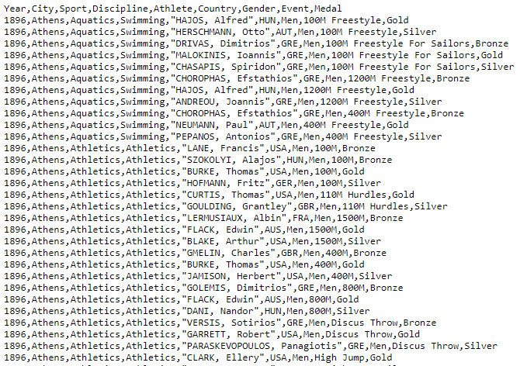
Data Used for Project:
Olympic Sport and Medals, 1896-2014
File Types: CSV Files
https://www.kaggle.com/the-guardian/olympic-games
Notes:
Three CSV files that contained data

Slide 5
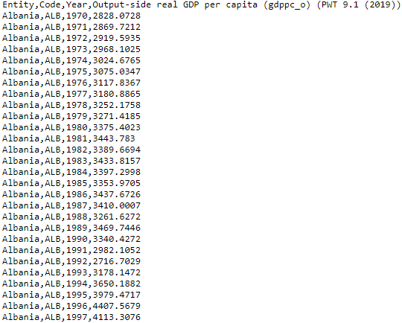
Data Used for Project cont.:
Historical GDPs: Our World in Data 1950 - 2017
File Types: CSV Files
https://ourworldindata.org/grapher/real-gdp-per-capita-pwt

Slide 6
Transform: What data cleaning or transformation required

Slide 7
Methodology:
Load the data into a structured SQL Database
Relevant Columns from Olympic Dataset:
Year
Medal
Country
Winter/Summer
Relevant Columns from Historical GDPs Dataset:
Year
Country
GDP Per Capita
Notes:
NICOLE STOPS HERE JASON STARTS ON NEXT SLIDE

Slide 8


Data Cleaning & Transformation
Checked for null values in the Olympics dictionary data
Deleted rows prior to 1950 and after 1914 (dates were not found in all datasets)
Removed columns related to individual athletes in team events and dropped duplicates
Notes:
After the imports, we initially looked for opportunities to clean it and transform it into a more focused, structured set of data that could be efficiently loaded into a relational database.
We looked for null values in the data sets and deleted rows representing years that were not common to both data sets.
We removed certain columns and then dropped duplicates after doing so, because we found that individual team member medals on medal winning teams were incorrectly being added to our medal counts.
We added columns representing "summer" and "winter", and we dropped unnecessary columns.
We then renamed multiple columns from brevity and to make sure we would not encounter problems when loading into our database due to mixed cases.

Slide 9
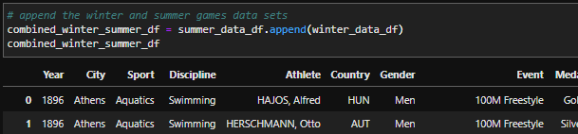

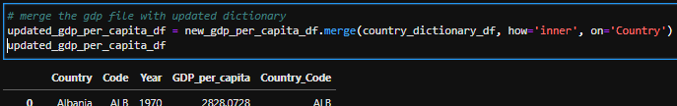
Data Cleaning & Transformation (cont.)
Appended Winter & Summer olympic datasets
Discovered & resolved 2 inconsistencies between different data sets
Added missing country codes to Olympics dictionary dataframe that were found in the grouped medals dataframe
Removed country codes from historical GDP file that didn't exist in the new Olympics dictionary dataframe
Notes:
We appended all historical olympic games data into one larger dataframe and we subtotaled the data, grouping it by games session, and by country in order to see medal counts.
Discovered and resolved 2 further inconsistencies in the data across the different data sets
Added missing country codes to the Olympics dictionary dataframe that were found in the grouped medals dataframe (eg. Yugoslavia & Czechoslovakia).
Created a list of unique missing codes
Researched to find the corresponding missing country names
Appended those country names and codes to the Olympics dictionary
Then removed country codes from the historical GDP file that did not exist in the new Olympics dictionary dataframe
Merged the dataframes using an inner join on Country name

Slide 10


Data Cleaning & Transformation (cont.)
Added a column to denote Winter or Summer Olympic games
Found missing country codes
Dropped unnecessary columns
Renamed columns for simple viewing

Slide 11
Notes, Inconsistencies, Outliers, & Anomalies
The dataset for the olympics had country codes that did not match the data from the GDPs
Some examples:
Independent Olympic Participants
West/East Germany
Soviet Union
West Indies Federation
GDP data only goes back to 1950’s
Olympic data stops at 2014
We did not take steps to verify the accuracy of the historical GDP data
Notes:
Notes about this dataset:
The Medals dataset contains countries that no longer exist
Soviet Union and West/East Germany has changed over time (Cold War 1949-1990).
West Indies Federation 1958-1962
There are also medal winners who participate on a unified team (no country associated)
The Gross Domestic Product was concept developed in 1934 US Congress report, in 1944 GDP became the main tool for measuring a country’s economy.

Slide 12
Load: the final database,
tables/collections
Notes:
We built the database in PostgreSQL because of the relative uniformity of the data that we were loading and due to the relative simplicity of the tasks we envision our SQL analysts performing on the database.

Slide 13
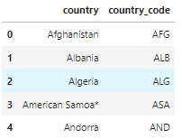
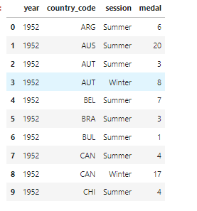
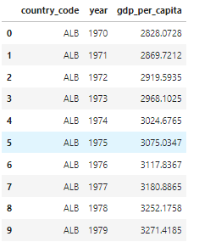
Dataframes
Notes:
Here are samples of the data from the dataframes that we created before loading into our database.
From left to right:
Country Master
Year/ Country Code / Medal Counts
GDP history
Joinable or common columns are country code and year

Slide 14
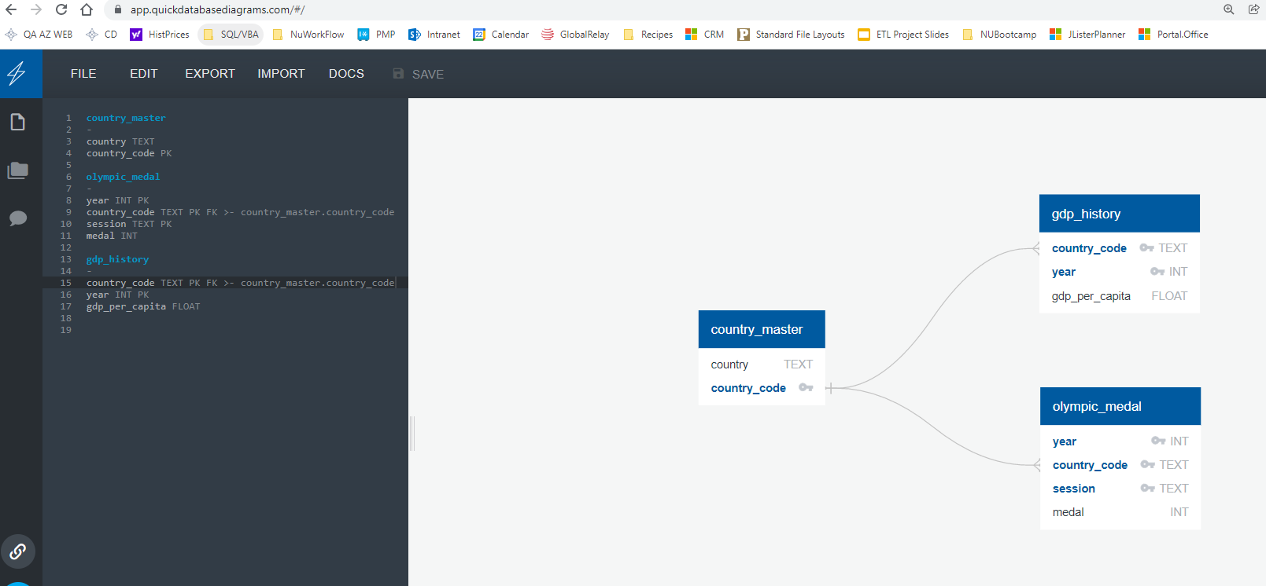
Olympics_db ERD
Notes:
In order to map out our production database, we first drew an ERD using Quick DBD.

Slide 15
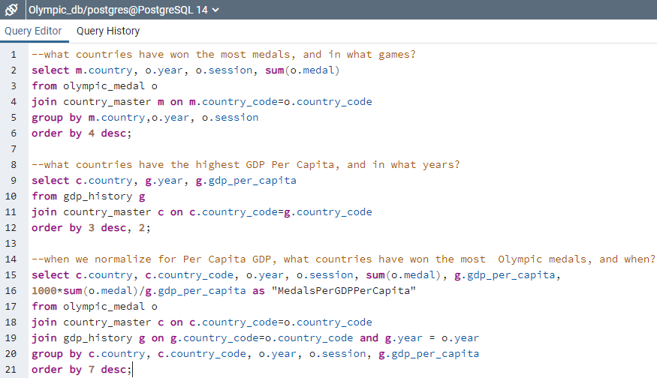
Potential SQL Queries for Production Team
Notes:
Our data analysts can easily perform queries on the database we created.

Slide 16
Possible Related Future Projects
Search for additional data sources (eg. Population growth, climate) to bring in to our database as an aid to our analysts so that they can look into other factors that may help explain olympic medal counts.
Notes:
*Another dataset we could have potentially used for more analysis would be population of countries over time

